Slide 1

Zomato New Restaurants
Manoj Mahawar

Slide 2

What is Zomato
Zomato is a online restaurant search and discovery service that provide information on home delivery, dining-out, cafes and nights.
Started in - July 2005,Delhi NCR
Founded by - Deepender Goyal, Pankaj Chaddah
Initially named as - “ FoodBoy” than in November 2010 renamed “Zomato”

Slide 3
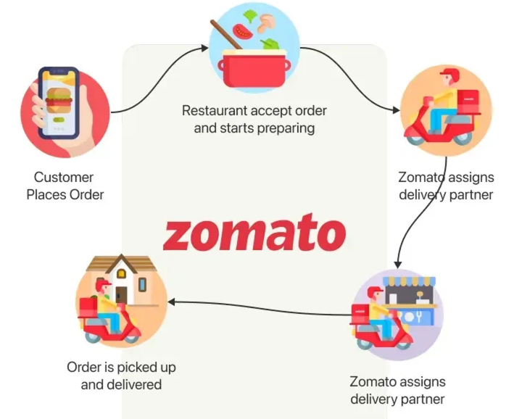
How Zomato works ?

Slide 4
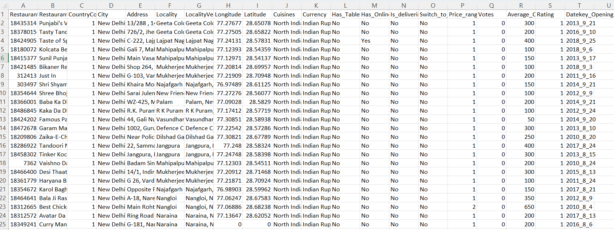
Problem Statement
You are hired as a consultant data analyst by zomato where the team is looking for expansion and opening restaurants. Your task is to come up with strategies/suggestions about opening newer restaurants.

Slide 5

Zomato MarketPlace DataSnapshot
Total Number of Restaurants: 9542 Restaurants present in all over the world that zomata work with these restaurants.
Number of Cuisines: Zomato provide 1825 different different cuisines with online food services with different different cities with fast and rapidly grow
Geographical Coverage: Services reached 15 countries and 140 cities in all over the world showing worldwide penetration

Slide 6
Data Cleaning and Preprocessing
Normalize the country based on country code, cities and states for accuracy in location based analysis
Find and Handle the missing value or data based on data cleaning purpose’
Convert the prices of all the currency with Indian Rupees(INR) to better understand what is average price of zomato food services in INR.
Add some column like Quarter wise, Year wise to understand how many restaurants based on Quarter wise
Extract the year wise data as well and rating range to established the range of rating like which range of rating restaurants are presents in market

Slide 7
Analytical Approach and Tools
Data Cleaning: Remove duplicates, convert the text into Dates to ensure the data accuracy.
Data Enhancement: Enhanced the dataset with additional variable using VLOOKUP, COUNT and SUM to cross reference external data source.
Descriptive Analysis: Employed Pivot table for summarizing key metrics and identify data pattern to across all the country with cuisines.
Customer Segmentation: Applied Sort and Filter function to classify customer based for ordering online food and services to applied.
Visualization: Create dynamic charts and dashboard for data representation, enabling interactive data exploration.

Slide 8
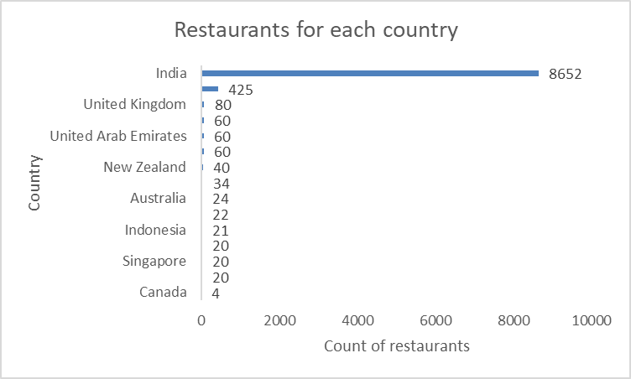
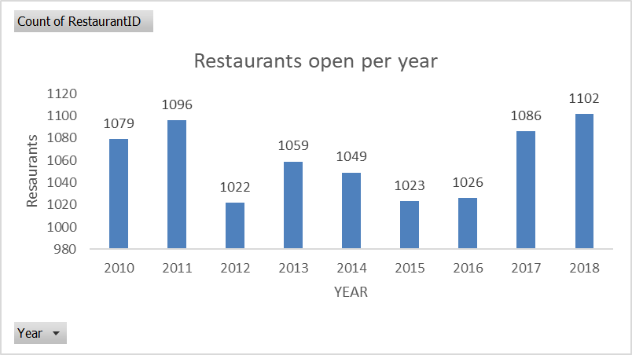
Analysis of Objective Questions
Identify the number of restaurants to each country to first understood strength of each country
for opening new restaurants where number of less competitor in a country
and also find the number of restaurants to open every year(2010-2018) to which year has more restaurants open and what reason to open high number of restaurants and less number of restaurants open

Slide 9
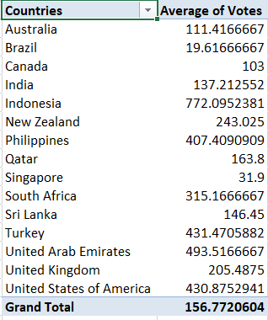
Find the average number of votes to major a peak values of customer feedback on given cuisines to
Identifies trends and consumer preferences, helping restaurant chains decide on potential new locations.
Helps in tailoring marketing efforts to regions with lower average votes to boost visibility and customer engagement.
We are using pivot table to identify the average numbers of restaurants open

Slide 10
Identify to average price per range which has less than 4 and also provide online delivery to
Understanding the average rating of affordable restaurants that offer online delivery helps assess the quality and customer satisfaction of such establishments.
Identifies potential for new restaurants in the affordable price range with online delivery, targeting a market segment that is popular and has high customer satisfaction.
Highlights the entire row of the cities / countries where we decided to open new restaurants for good presentations.
fs = If(and(price_range<4, online_order=”Yes”),rating,” ”))

Slide 11
Extract the country name into raw data based on country code where we use vlookup function.
Extract the total number of restaurants in India with price range 4.
Extract the price range which has lowest price =1 and does not provide the online delivery also cost of two person <= 250. We use array formula.
fs = VLOOKUP(C17,'Country Description'!$A$2:$B$16,2,0)
fs=COUNTIFS(Row_data!$E$2:$E$9543,"India",Row_data!$S$2:$S$9543,4).
fs: {=SUM(IF((P2:P9543="No")*(S2:S9543<2)*(V2:V9543<=250),1,0))}

Slide 12
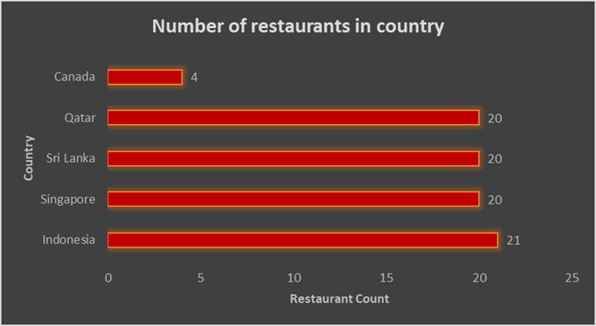
Analysis of Subjective Questions
Identify few countries where we can open new restaurants follow three major things:-
Find the less number of restaurants in each country so we can terminated the higher number of country because if number is already too high than there no points to open new restaurants because too much competitions.
Average rating of cuisines in less number of restaurants open in country so we can focus on where rating is good and average.

Slide 13
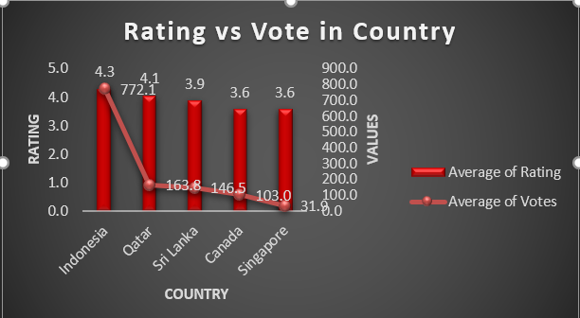
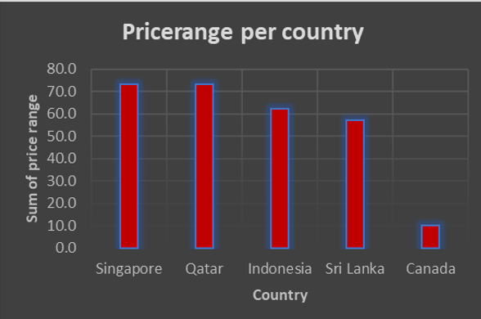
Calculate the feedback of every cuisines of every restaurants for better understand. Feedback analysis helps identify common issues faced by customers. Addressing these issues before opening can improve customer satisfaction, leading to better reviews and repeat business.

Slide 14
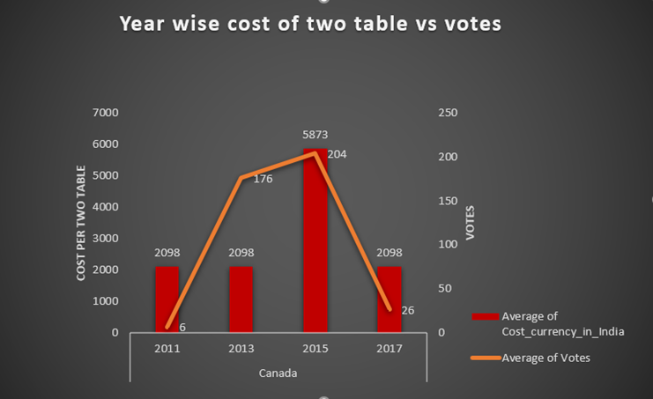
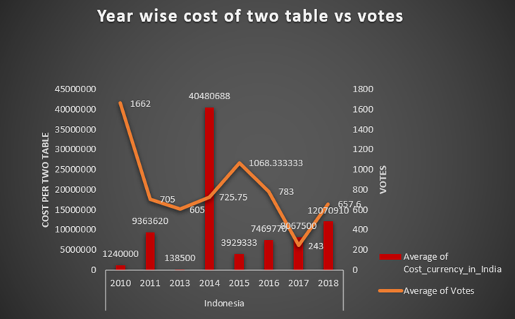
In suggestion country take care of food or cuisines when open to new restaurants so basically we are using average price per two table as well average feedback on every cuisines and check the correlation between rating and feedback if both have provide any relationship then we will take care should be provide same cuisines or not.

Slide 15
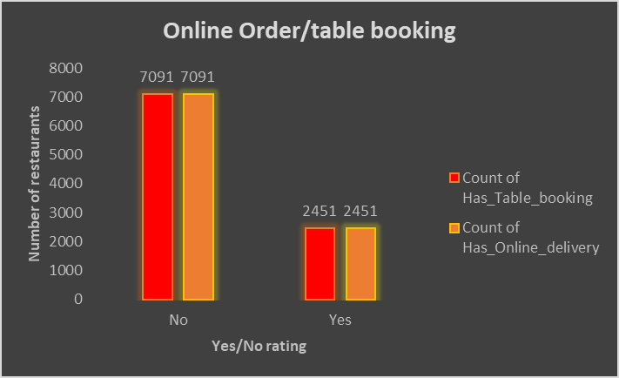
Analysis the online delivery like for what is % overall they provide online delivery and online table booking or not if some country has no online delivery than it’s good to not provide the online services otherwise yes based on below data overall count of not providing the online services is higher compare to providing.
Country | Count of Has_Table_booking | Count of Has_Online_delivery
No | 7091 | 7091
Yes | 2451 | 2451
Grand Total | 9542 | 9542

Slide 16
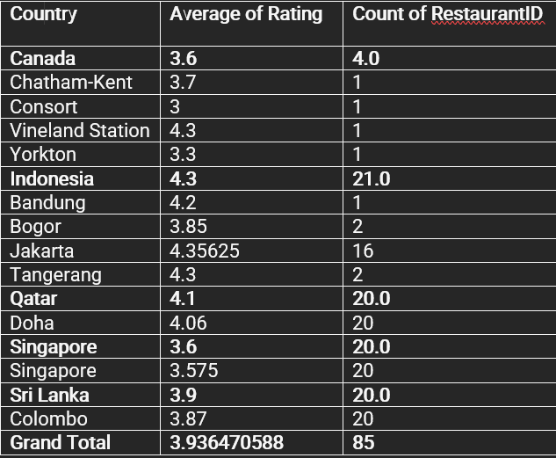
In the right side of data snapshot we extract those restaurants in suggestion
Country which has high rating to understood
the criteria when open a new
restaurants . Here we found some
Restaurants in some country they give
Competitor when new restaurants open.
So we use pivot table to extract those
data.

Slide 17
Strategic Recommendations
Target Countries with High Average Ratings:
Reason: Countries like Philippines, Turkey and UAE have a high average restaurants rating, indicating a strong customer base that value quality dining experiences.
Expected Impact: Improved customer satisfaction and higher chances of successful restaurant openings due to positive dining cultures.
Leverage Data-Driven Marketing Strategies:
Reason: Utilize targeted advertising on platforms like Google Adwords to attract the right audience by focusing on popular keywords and dining trends in the target market.
Expected Impact: Increased visibility and customer acquisition, leading to higher initial footfall and online orders.

Slide 18
Analyze Market Saturation:
Reason: Select countries with moderate to low market saturation to avoid intense competition and capture a significant market share.
Expected Impact: Increased market share and a better foothold in the market.
Focus on Customer Satisfaction Metrics:
Reason: Ensuring high customer satisfaction is correlated with increased market share and profitability
Expected Impact: Sustained growth and improved brand reputation in the new market.

Slide 19
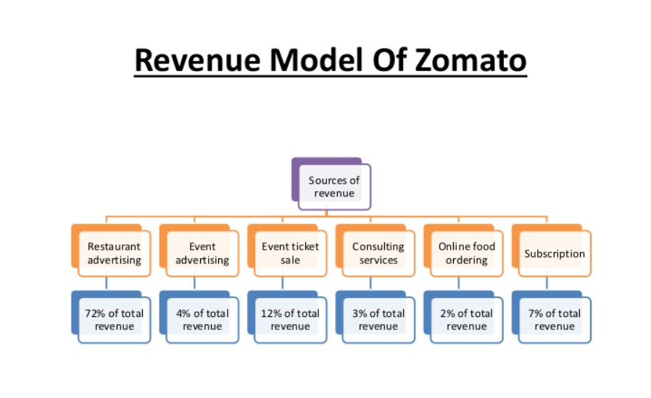

Slide 20
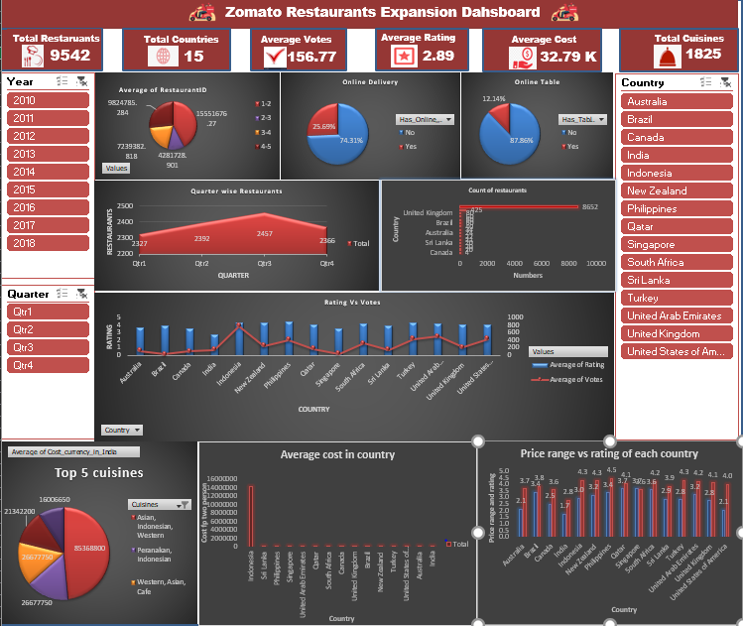
Dashboard and visualization

Slide 21
In above dashboard I focus some insight like:
Check online delivery and online table booking in overall country when we open new restaurants we should follow this procedure or not.
Differentiate the rating in a rating range like 1-2, 2-3, 3-4 and 4-5 to identify the average rating of every rating range and number of restaurants are there in every range to gain good insight when open new restaurants.
Check the quarter wise restaurants open which quarter has more restaurants open and which country it’s open.
Identify the average rating and average votes of to get some insight where feedback are good rating as well high so we find the correlation between them.
Extract the top 5 cuisines with higher price all over world.

Slide 22
Summary
Planning to open new Zomato restaurants in all over the world with provided raw data.
Data contain: Restauranst_name, City, Country, Date of restaurants,ID, Cuisines and more field to understand the data as well approach and clean the data, manipulate the data based on requirements needed.
Extract the lesser number of restaurants where crowded are less and rating good to easy to open new restaurants but user feedback also important if feedback are good then rating also good.
Check the price of every cuisines what kind of dishes people like most with good feedback.
Understood number of restaurants open each year in every country to analysis the data ratio.
In final we create the dashboard with slicer so it check the how data changes based on Year, Country and Quatar.

Slide 23
Conclusion
Market Penetration:
Conduct thorough market research to understand the local dining habits, preferences, and competition.
Adapt the menu and services to suit local tastes and preferences to create a sense of localness
Marketing Strategy:
Utilize a multi-channel marketing approach, including Google Adwords, social media marketing, influencer partnerships, and email campaigns to build brand awareness and attract customers.
Focus on local SEO optimization to ensure visibility in local searches for dining options.

Slide 24


Partnerships and Collaborations:
Partner with local influencers, food bloggers, IRCTC and other businesses to promote the new restaurants and create buzz in the community.
Continuous Improvement:
Gather feedback from customers and use it to continuously improve the offerings and services.
Monitor performance through data analytics and adjust strategies as needed to ensure sustained growth.

Slide 25
Acknowledgements and References
References: https://www.shiksha.com/online-courses/articles/zomato-digital-marketing-strategy/
https://skillcircle.in/zomato-marketing-strategy/

